Slide 1

Team 2’s Weekly Check-in

Slide 2
A Brief View of how we Envisage Your Product

Slide 3
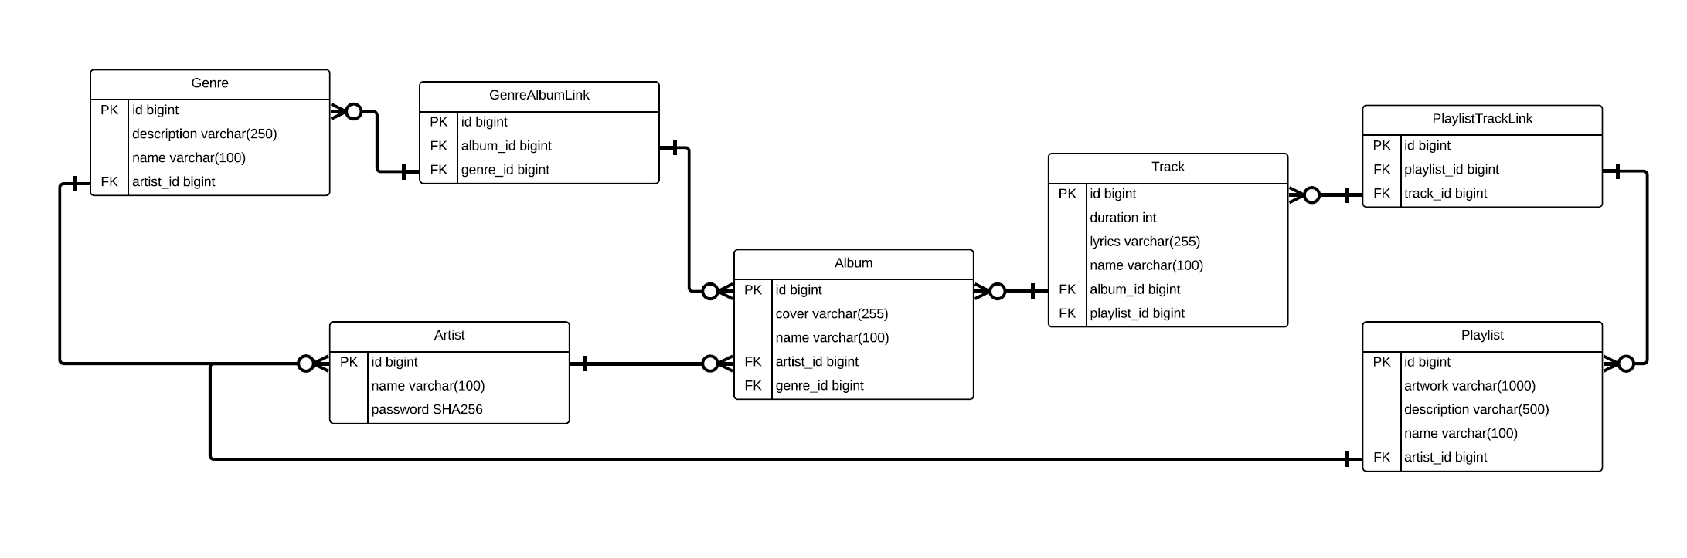
Original Relationships

Slide 4
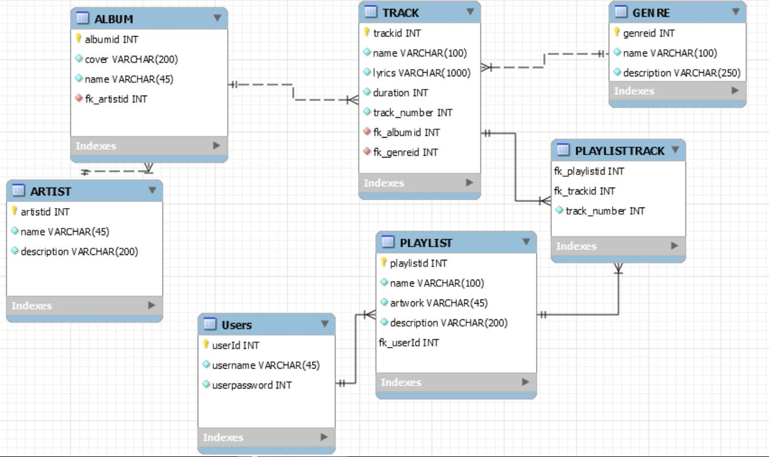
How we View it Now

Slide 5
Our View For Your Site

Slide 6
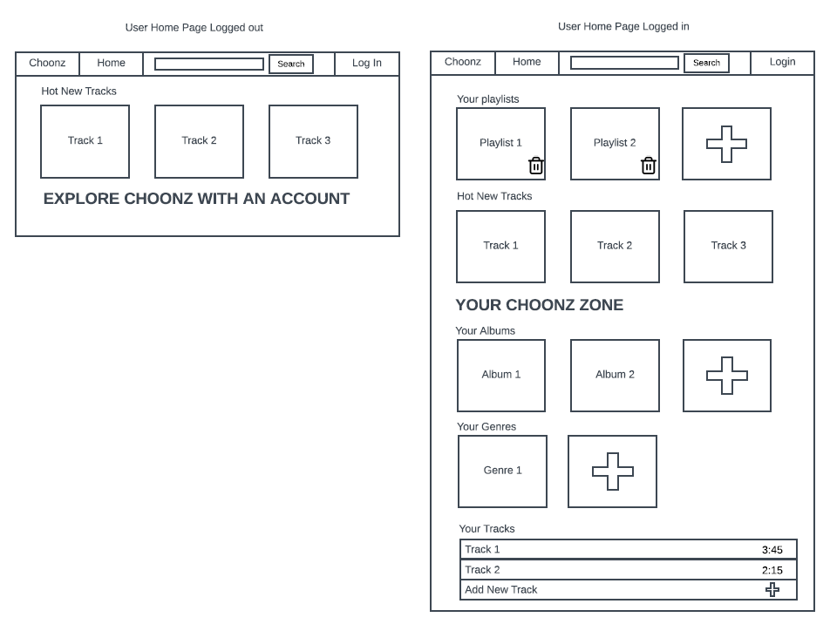
Home Page
As you can see, we have designs for both logged in and logged out status, with a dynamic approach to providing the front-end webpage.

Slide 7
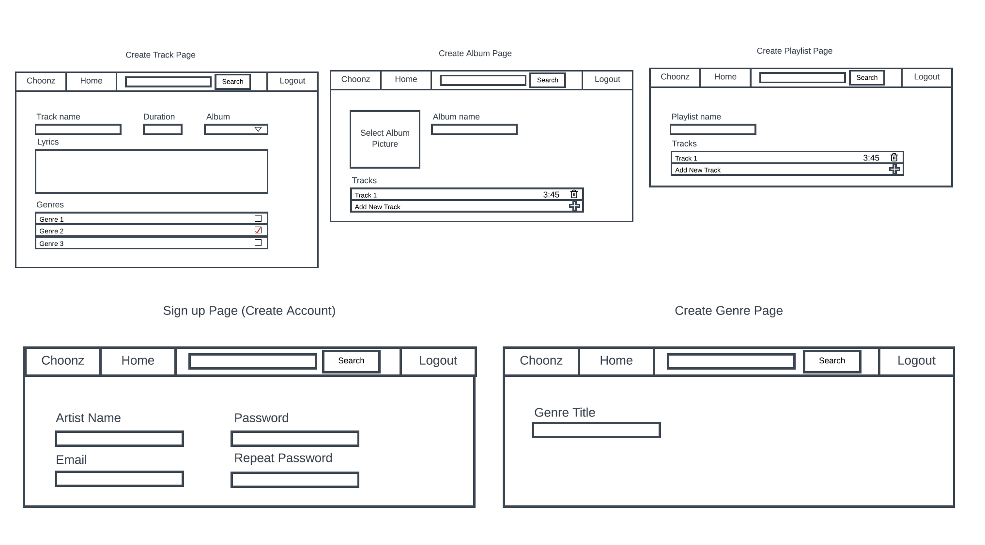
Create Pages
On this slide you can see our vision for how we create the elements of the site.

Slide 8
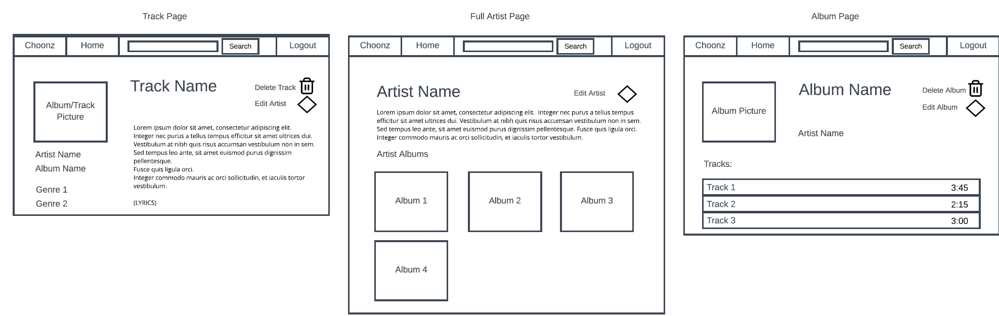
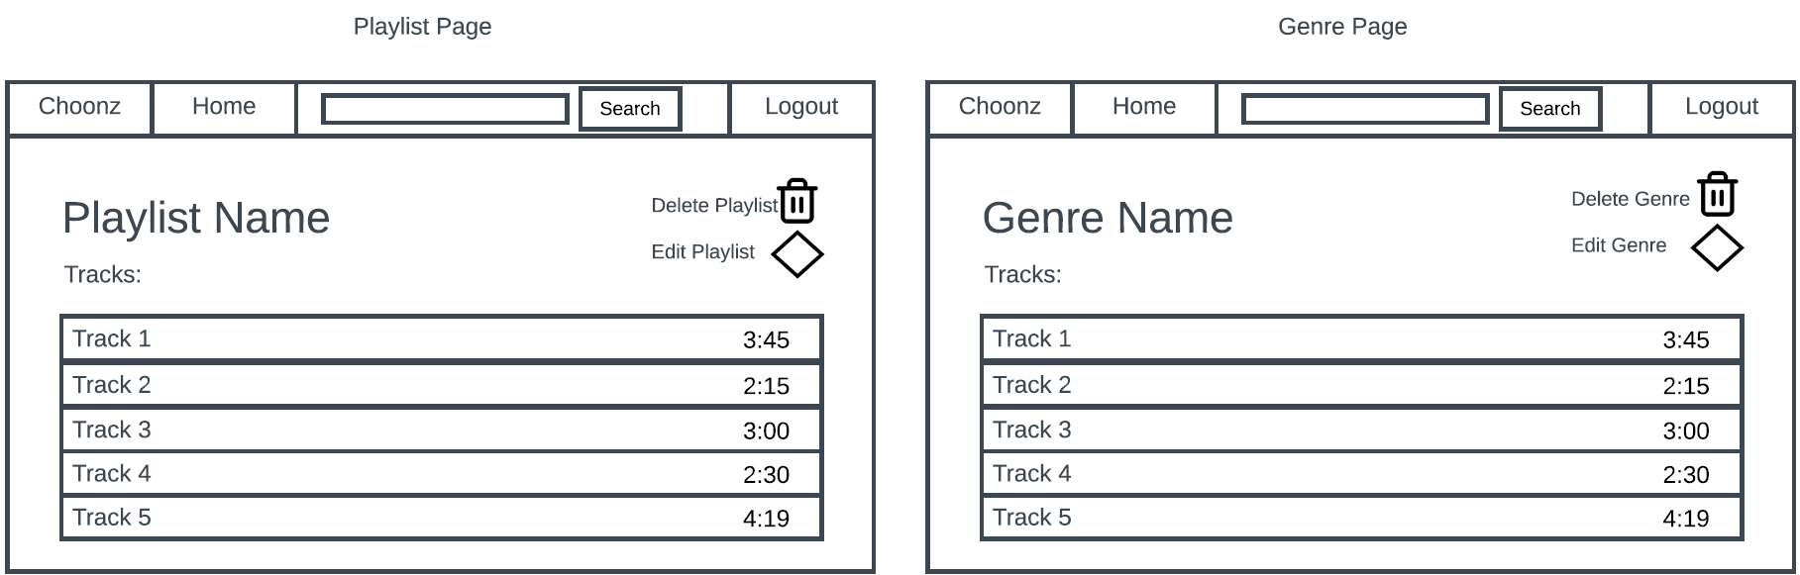
Main Pages
Here we have our vision for how the pages will look for each element of the product.
Each one is dynamic and scaleable.

Slide 9
Quick Demo!
Lets put our vision into practice!

Slide 10
Testing Your Product

Slide 11
This weeks Testing Accomplishments!
Focuses:
We wanted to focus this week on getting back-end, functional testing done. The tests are subject to change as we look to change, and improve, the code-base to help make the best product possible.
We currently have 120 tests, 70 Unit Tests, 50 Integration tests. As the code base changes, so will our tests and this is something we’ll monitor throughout.
This week has been a success in terms of testing, it leaves us plenty of time, with plenty of room to improve, optimise and make successful.

Slide 12
Next Weeks Testing Goals
Focuses:
Next week we want to make sure to target the functionality of the front-end system. It is therefore our priority to make Load, Soak, Spike, and Stress tests for the server and the system so we can see its capabilities under stress.
We also want to fix the issues we were having this week, with a changing codebase comes changing test-base.
Our aim is to have full documentation of all tests, submitted in an easy to read format with documentation on what each aspect of the testing means.

Slide 13
Goals for Next Week!
First and Foremost the product needs to work. Any changes you would like to see made to the product and how it works will be our top priority going forward. Functionality to meet the minimum viable product is essential to us.
We don’t want your product going production and you find significant bugs with the product, it is therefore essential to us that we meet all the testing requirements you set for us. That being said, we want to ensure that our back-end testing meets the industry required 80%, and if we can get more, we will.
Functionality and Testing, our two most important goals. However, we also want to make the site an enjoyable experience, it is therefore our third priority to make your site as appealing as possible, to make it accessible, usable, and somewhat fun to use as well.

Slide 14
Any Questions?
Thank you for your time. We greatly appreciate your input and your feedback.
Any and all comments are welcome, as we are here to serve you and your company to the best of our abilities.
By the end of next week, we’ll have your product done and ready for production! We have our best minds on it!

